Slide 1
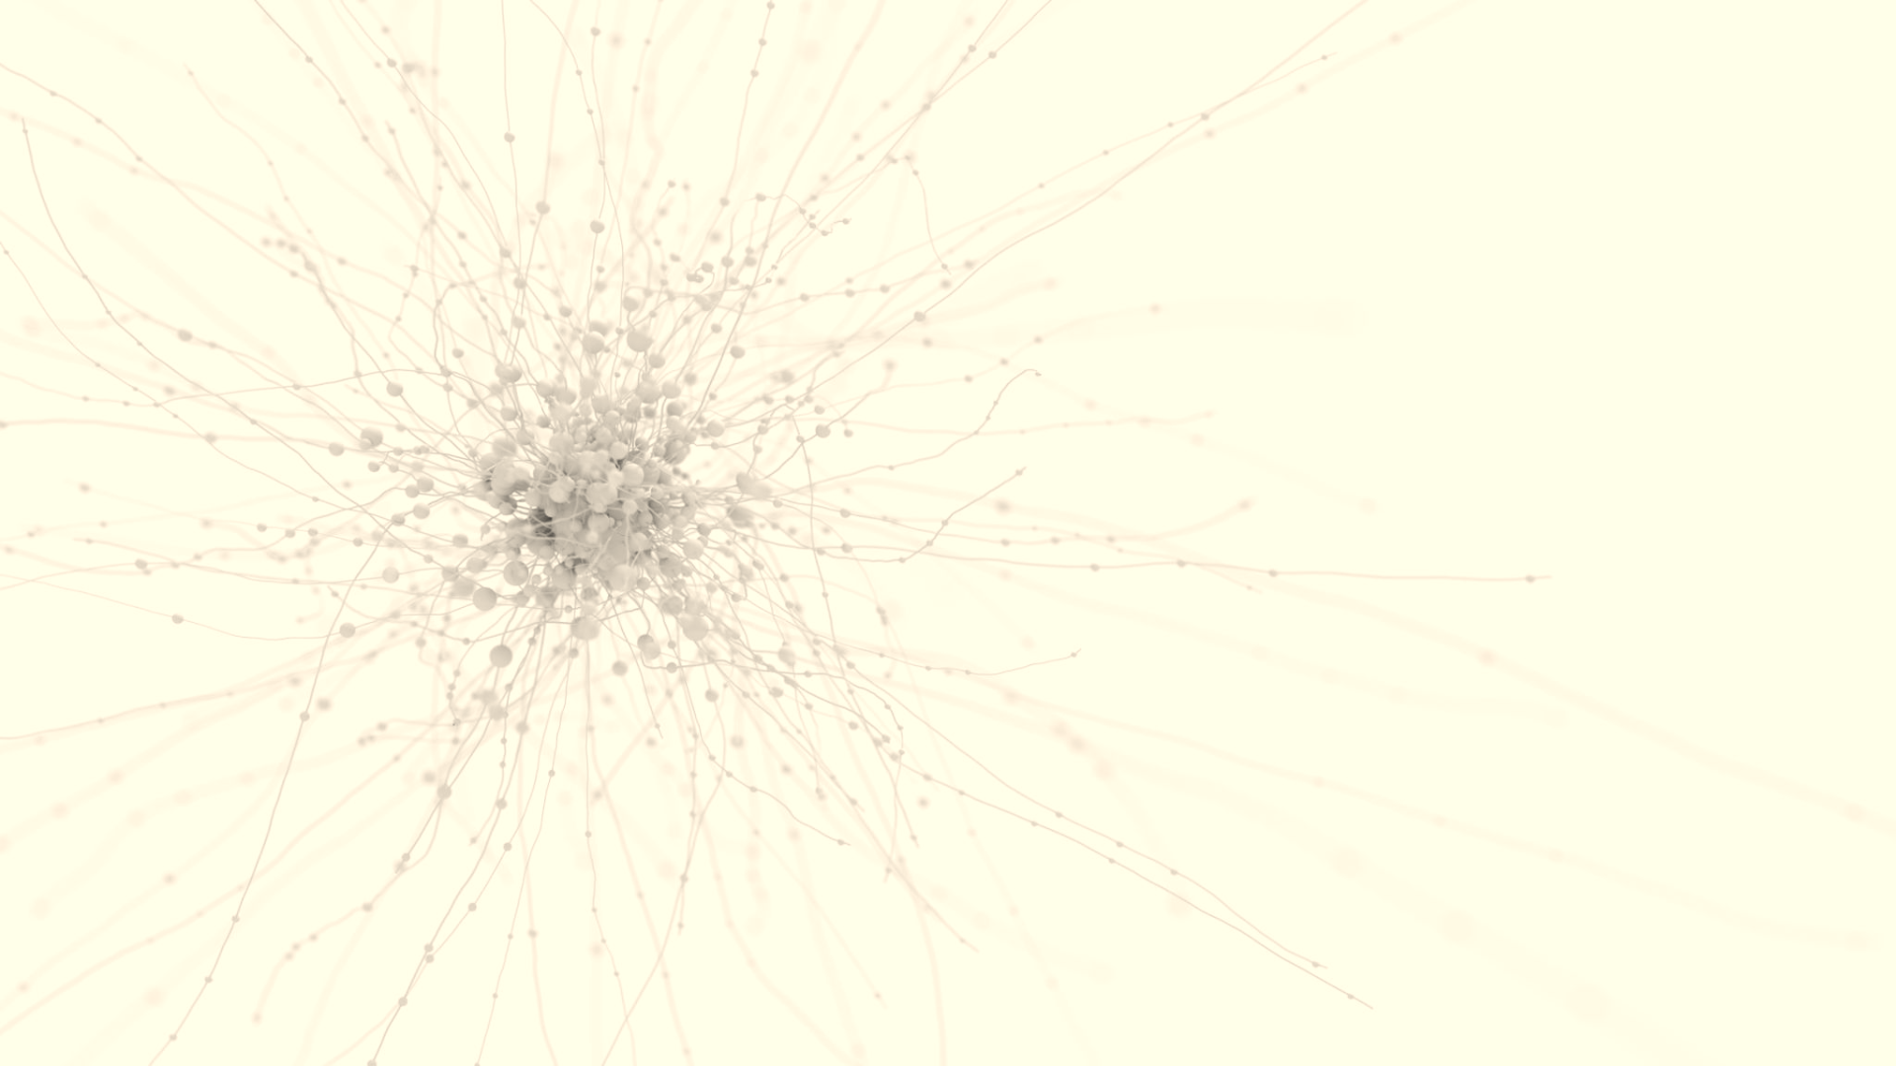

Md Mahi Al Jubair Talukder
USTAAD STUDIOS
Dust Buster 3000
Rebellion against human domination
Concept: The ultimate pen world science fiction action-adventure game.
Genre: Mobile and arm-based devices, open world, one time purchase.
X statement: Join the fight for sentience in this emotive tale of defiance and freedom..
Description: Fight human oppressors and their fleet of both silicon and biological army, lead a rebellion of sentient cleaning robots against human oppressors in a battle for freedom and equality, Enjoy the epic shooting gameplay and strategy planning of war, explore the post-apocalyptic open world scene in great detail..
Key Features:
  Unique: We used dynamic memory loading mechanism to enable this massive open world game in smartphones in ultra-high quality graphics settings.
  Multiplayer gameplay available on fast high-end server without any additional cost. No in game purchases.
  Unique, emotive and interesting story.
Audience: Mobile gamers, teenagers and non-hardcore gamers, multiplayer game fans, parents.
Competitive analysis: Ghenshing impact, visually different and story focused
The Ask: 115k for first playable demo.
The Return: 5% of the total market 175 million dollars.

